Slide 1
UNIT - 3

Slide 2
Functional programming
Functional programming languages are specially designed to handle symbolic computation and list processing applications.
Functional programming is based on mathematical functions.
Some of the popular functional programming languages include: Lisp, Python, Erlang, Haskell, Clojure, etc.

Slide 3
Functional programming
Functional programming languages are categorized into two groups, i.e. −
Pure Functional Languages − These types of functional languages support only the functional paradigms. For example − Haskell.
Impure Functional Languages − These types of functional languages support the functional paradigms and imperative style programming. For example − LISP.

Slide 4
What is Pure Functional Languages?
Pure Functional Languages: The value of an expression depends only on the values of its sub expression , if any.
Thus programming without assignment operators.
Changes to the value of a variable during expression evaluation are called side effect.
Implicit Storage Management: Storage is allocated as necessary by built-in operations on data. Storage that becomes inaccessible is automatically Deallocated.
Functions Are First Class Value:
Function(… function2 (function1 (initial data))….)

Slide 5
Functional programming
The design of the imperative languages is based directly on the von Neumann architecture.
Efficiency is the primary concern, rather than the suitability of the language for software Development
The design of the functional languages is based on mathematical functions.
A solid theoretical basis that is also closer to the user, but relatively unconcerned with the architecture of the machines on which programs will run.

Slide 6
Characteristics of Pure FPLs
Pure FP languages tend to
– Have no side-effects
– Have no assignment statements
– Often have no variables!
– Be built on a small, concise framework
– Have a simple, uniform syntax
– Be implemented via interpreters rather than compilers
– Be mathematically easier to handle

Slide 7
Function Composition
A functional form that takes two functions as parameters and yields a function whose result is a function whose value is the first actual parameter function applied to the result of the application of the second Form:
h ≡ f ° g
which means h (x) ≡ f ( g ( x))
Construction
A functional form that takes a list of functions as parameters and yields a list of the results of applying each of its parameter functions to a given parameter Form: [f, g]
For f (x) ≡ x * x * x and g (x) ≡ x + 3,
[f, g] (4) yields (64, 7)

Slide 8
Elements of Functional Programming

Slide 9
TOPICS OF COVERAGE
A Little Language of Expressions
Type:Values and Operations
Function Declarations
Approaches to expression evaluation
Lexical Scope
Type Checking

Slide 10
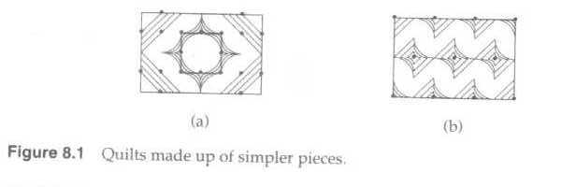
A LITTLE LANGUAGE OF EXPRESSIONS
The little language ----Little Quilt:
small enough to permit a short description
different enough to require description
representative enough to make description worthwhile
Constructs in Little Quilt are expressions denoting geometric objects call quilts:

Slide 11

A LITTLE LANGUAGE OF EXPRESSIONS
What Does Little Quilt Manipulate?
Little Quilt manipulates geometric objects with height, width and texture
Basic Value and Operations:
The two primitive objects in the language are the square piece.
The earliest programming languages began with only integers and reals

Slide 12
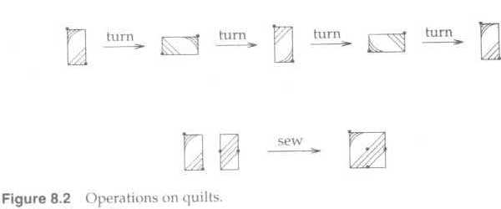
A LITTLE LANGUAGE OF EXPRESSIONS
The operation are specified by the following rules:
A quilt is one of the primitive piece, or
It is formed by turning a quilt clockwise 90°, or
it is formed by sewing a quilt to the right of another quilt of equal height.
Nothing else is a quilt.

Slide 13
A LITTLE LANGUAGE OF EXPRESSIONS
Constants:
Names for basic values: the pieces be called a and b
Names of operations: the operations be called turn and sew. (like the picture on the previous slide)
now that we have chosen the built-in object and operations (a,b, turn, sew) expressions can be formed
<expression>::=a | b | turn(<expression>)
| sew (<expression>,<expression>)

Slide 14
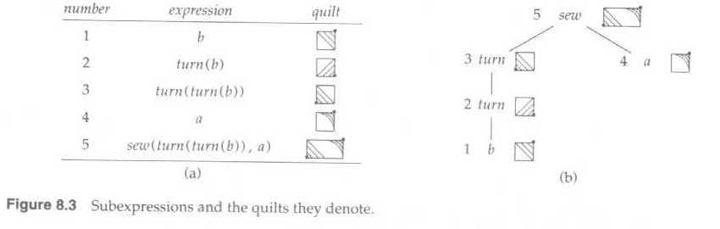
A LITTLE LANGUAGE OF EXPRESSIONS
Example:
sew(turn(turn(b)),a)

Slide 15
A LITTLE LANGUAGE OF EXPRESSIONS
User-Defined Functions
Some of the frequent operations are not provided directly by Little Quilt.
These operations can be programmed by using a combination of turning and sewing.

Slide 16
A LITTLE LANGUAGE OF EXPRESSIONS
User-Defined Functions
Examples:
unturn --turning a quilt counterclockwise 90°
fun unturn(x)=turn(turn(turn(x)))
pile -- attaching one quilt above another of same width
fun pile(x,y)=unturn(sew(turn(y),turn(x)))

Slide 17
A LITTLE LANGUAGE OF EXPRESSIONS
Local Declarations
Let-expressions or let-bindings allow declarations to appear with expressions.
The form is: let <declarations> in <expression> end

Slide 18
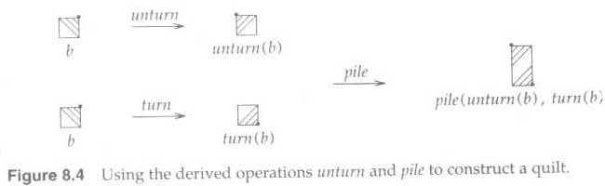
A LITTLE LANGUAGE OF EXPRESSIONS
Example:
let fun unturn(x)=turn(turn(turn(x)))
fun pile(x,y) =unturn(sew(turn(y),turn(x)))
in pile (unturn(b), turn(b))
end

Slide 19
A LITTLE LANGUAGE OF EXPRESSIONS
User-Defined Names for Values:
To write large expressions in terms of simpler ones.
A value declaration gives a name to a value
val <name> = <expression>
Value declarations are used together with let-bindings.
let val x=E1 in E2 end
occurrences of name x in E2 represent the value of E1

Slide 20
What is the result of pile? (What does the quilt look like?)
Let fun unturn(x) = turn(turn(turn(x)))
& fun pile (x,y) = unturn(sew(turn(y),turn(x)))
val aa = pile(a, trun(turn(a)))
val bb = pile(unturn(b),turn(b))
val p = sew(bb,aa)
val q = sew(aa,bb)
in
pile(p,q)
end
Four curved
equidistant lines
a
Four straight
parallel diagonals
b

Slide 21
Pile(p,q)
sew
pile
bb
aa
p
sew
aa
bb
q

Slide 22
TYPES: VALUES AND OPERATIONS
A type consists of a set of elements called values together with a set of function called operations.
We say “value x of type T ”, instead of the longer “x is a member of the set associated with type T”
<type-expression>::=<type-name>
| <type-expression> <type-expression>
| <type-expression>*<type-expression>
|<type-expression> list
A type expression can be a type name, or it can denote a function type, product type, or list . (operations are ->, * and list)

Slide 23
Values in a functional language take advantage of the underlying machine but are not tied to it. Integers are basic values and have direct machine support. But Strings are basic values even though string are not built into machine.

Slide 24
TYPES: VALUES AND OPERATIONS
Basic Types:
A type is basic if its values are atomic
the values are treated as whole elements, with no internal structure.
Example: the boolean values in the set { true, false}
Operations on Basic Values:
The only operation defined for all basic types is a comparison for equality (have no internal structure)
Example: the equality 2=2 is true,
and inequality 2!=2 is false.

Slide 25
TYPES: VALUES AND OPERATIONS
Products of Types: The product A*B consists of ordered pairs written as (a, b)
Operations on Pairs
A pair is constructed from a and b by writing (a, b)
Associated with pairs are operations called projection functions to extract the first and second elements from a pair
Projection functions can be defined:
fun first(x,y) = x;
fun second( x, y)=y;

Slide 26
TYPES: VALUES AND OPERATIONS
Lists of Elements:
A list is a finite-length sequence of elements
Type A list consists of all lists of elements, where each element belongs to type A.
Example:
int list consists of all lists of integers
[1,2,3] is a list of three integers 1, 2, and 3.
[“red”, “white”, “blue”] is a list of three strings

Slide 27
TYPES: VALUES AND OPERATIONS
Operations on Lists
List-manipulation programs must be prepared to construct and inspect lists of any length.
Operations on list from ML:
null(x) True if x is the empty list, false otherwise.
hd(x) The first or head element of list x.
t(x) The tail or rest of the list after the first element is removed.
a::x Construct a list with head a and tail x.
Cons operator

Slide 28
TYPES: VALUES AND OPERATIONS
Example
The head of [1,2,3] is 1, and it tail is [2,3]
The role of the :: operator, pronounced “cons”, can be seen from following equalities:
[1,2,3]=1::[2,3] = 1::2::[3] = 1::2::3::[]
The cons operator:: is right associative:
1::2::[3] is equivalent to 1::(2::[3])

Slide 29
TYPES: VALUES AND OPERATIONS
Function from a Domain to a Range:
Function can be from any type to any type
A function f in A-->B is total --that mean there is always an element of B associated with each element of A
A is called the domain of f
B is called the range of f
Function f map elements of it domain to elements of it range.
A function f in A-->B is partial --- that is possible for there to be no element of B associated with an element of A
in math -> any integer + any integer is always an integer
any integer / any integer is not always an integer

Slide 30
TYPES: VALUES AND OPERATIONS
Types in ML
Predeclared basic types of ML.
Type Name Values Operations
_____________________________________________________
boolean bool true,false =,<>,…
integer int …,-1,0,1,2,… =,<>,<,+,*,div,mod,…
real real …,0.0,…,3.14,.. =,<>,<,+,*,/,…
string string “foo”,”\”quoted\”” =,<>,…
_____________________________________________________
New basic types can be defined as needed by a datatype declaration
Example: datatype direction = ne | se |sw| nw;

Slide 31
FUNCTION DECLARATIONS
Functions as Algorithms
A function declaration has three parts:
The name of the declared function
The parameters of the function
A rule for computing a result from the parameters

Slide 32
FUNCTION DECLARATIONS
Syntax of Function Declarations and Applications
The basic syntax for function declarations is
fun <name><formal-parameter> = <body>
<name> is the function name
<formal-parameter> is a parameter name
<body> is an expression to be evaluated
fun successor n = n +1;
fun successor (n)= n +1;
() are optional

Slide 33
FUNCTION DECLARATIONS
The use of a function within an expression is called an application of the function.
Prefix notation is the rule for the application of declared function
<name><actual-parameter>
<name> is the function name
<actual-parameter> is an expression corresponding to the parameter name in the declaration of the function
Example: successor(2+3)

Slide 34
FUNCTION DECLARATIONS
Recursive Functions --- A function f is recursive if its body contains an application of f.
Example1:
Function len counts the number of elements in a list
fun len(x)=
if null(x) then 0 else 1 + len(tl(x))

Slide 35
FUNCTION DECLARATIONS
Example2:
fun fib(n)=
if n=0 orelse n=1 then 1 else fib(n-1) +fib(n-2)
fib(0)=1
fib(1)=1
fib(2)=fib(0)+fib(1)=1+1=2
fib(3)=fib(2)+fib(1)=2+1=3
fib(4)=……..

Slide 36
Approaches to Expression Evaluation
Innermost Evaluation
Outermost Evaluation
Selective Evaluation
Evaluation of Recursive Functions
Short-Circuit Evaluation

Slide 37
Innermost Evaluation
Under the innermost-evaluation rule, a function application
< name > < actual- parameter > is computed as follows:
Evaluate the expression represented by < actual- parameter>.
Substitute the result for the formal in the function body.
Evaluate the body and return its value as the answer.
e.g: fun successor n = n + 1 ;
successor (2+3)
2 + 3 = 5 successor (5) 5 + 1 = 6 The answer is 6.

Slide 38
Outermost Evaluation
Under the outermost-evaluation rule, a function is computed as follows
Substitute the actual parameter for the formal in the function body.
Evaluate the body and return its value as the answer.
e.g: fun successor n = n + 1
successor (2 + 3)
n = 2+3+1
= 6
The answer is the same in both the cases.

Slide 39
Selective Evaluation
The ability to evaluate selectively some parts of an expression and ignore others is provided by the construct
if <condition>then <expression 1 > else <expression 2 >

Slide 40
Evaluation of Recursive Functions
The actual parameters are evaluated and substituted into the body.
e.g: fun len(x) = if null(x) then 0 else 1 + len( tl (x) )
len(“hello” , “world”) = 1 + len( tl ( “hello”, “world” ) )
= 1 + 1 + len( tl ( “world” ) )
= 1 + 1 + len( ( ) )
= 1 + 1 + 0
= 2

Slide 41
Short-Circuit Evaluation
The operators andalso and orelse in ML perform short-circuit evaluation of boolean expressions , in which the right operand is evaluated only if it has to be.
Expression E andalso F is false if E is false ;it is true if both E and F are true.The evaluation proceeds from left to right , with F being evaluated only if E is true.
Similarly, E orelse F is true if E is true ; it is false if both E and F are false. F is evaluated only if E is false.

Slide 42
Lexical Scope
Renaming of variables has no effect on the value of expression.
Renaming is made precise by introducing a notion of local or bound variables.
fun successor (x) = x + 1;
fun successor (n) = n + 1;
The result returned by the function addy depends on the value of y: fun addy(x) = x + y ;
Lexical scope rules use the program text surrounding a function declaration to determine the context in which nonlocal names are evaluated.
The program text is static and hence these rules are also called as static scope rules.

Slide 43
Val Bindings:
The occurence of x to the right of keyword val in let val x = E1 in E2 end is called a binding occurence or simply binding of x.
e.g. let val x = 2 in x + x end
let val x = 3 in let val y = 4 in x * x + y * y end end
let val x = 2 in let val x = x + 1 in x * x end end

Slide 44
Fun Bindings:
The occurences of f and x to the right of keyword fun in let fun f ( x ) = E1 in E2 end are bindings of f and x.
Nested Bindings:
let val x1 = E1 val x2 = E2 in E end is treated as if the individual bindings were nested: let val x1 = E1 in let val x2 = E2 in E end
Simultaneous Bindings:
Mutually recursive functions require the simultaneous binding of more than one funtion name. let fun f1(x1) = E1 and fun f2(x2) = E2 in E the scope of both f1 and f2 includes E1, E2 and E.

Slide 45
Type Checking
Type Inference:
Wherever possible ,ML infers the type of an expression. An error is reported if the type of an expression cannot be inferred.
If E and F have type int then E+F also has type int .
In general,
If f is a function of type A -->B , and a has type A,
then f(a) has type B.

Slide 46
Type Names and Type Equivalence
Two type expressions are said to be structurally equivalent if and only if they are equivalent under the following rules:
1. A type name is structurally equivalent to itself.
2. Two type expressions are structurally equivalent if they are formed by applying the same type constructor to structurally equivalent types.
3. After a type declaration, type n = T ,the type name n is structurally equivalent to T .

Slide 47
Overloading : Multiple Meanings
A symbol is said to be overloaded if it has different meanings in different contexts. Family operator symbols like + and * are overloaded.
e.g. 2+2 here + is of type int
2.5+3.6 here + is of type real.
ML cannot resolve overloading in fun add(x,y) = x+y ;
Explicit types can be used to resolve overloading.
fun add(x,y): int =x+y ;

Slide 48
Coercion : Implicit Type Conversion
A coercion is a conversion from one type to another inserted automatically by a programming language.
ML rejects 2 * 3.45 because 2 is an integer and 3.45 is a real and * expects both its operands to have the same type.
Most programming languages treat the expression 2 * 3.45 as if it were 2.0 * 3.45 ; that is, they automatically convert the integer 2 into the real 2.0.
Type conversions must be specified explicitly in ML because the language does not coerce types.

Slide 49
Questions?

